Slide 1




EMPLOYEE MANAGEMENT SYSTEM
Presented by
Dikshitha
Yasaswini
Karthi

Slide 2
INTRODUCTION
The Employee Management System (EMS) is designed to simplify and organize the management of employee-related information within an organization. This project uses a relational database model to efficiently handle various aspects of employee data, including personal details, job roles, departmental structures, payroll processing, qualifications, and leave records. By integrating these modules, the system ensures smooth HR operations, better data consistency, and easy reporting.

Slide 3
The database consists of six interrelated tables:
JobDepartment – Stores job roles, department details, and salary ranges.
SalaryBonus – Manages salary, annual pay, and bonuses linked to job roles.
Employee – Maintains employee details, including demographics, contact information, and job assignments.
Qualification – Tracks employee qualifications, skills, and requirements for specific roles.
Leaves – Records employee leave history with reasons and dates.
Payroll – Integrates employee, job, salary, and leave data to calculate net payments.

Slide 4
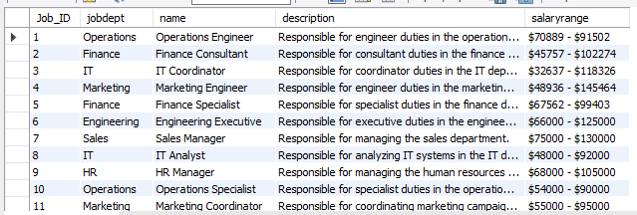
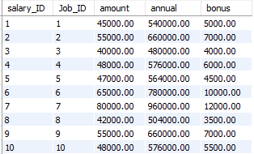
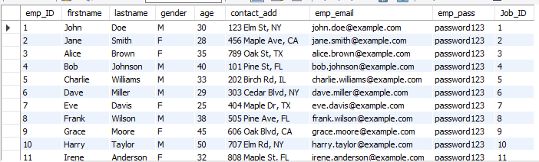
Job Department
Salary
Employee

Slide 5
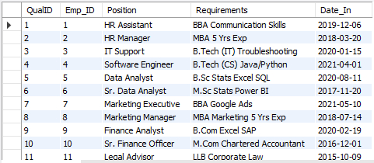
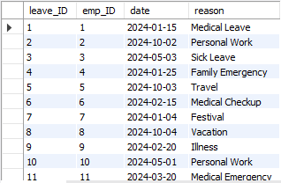
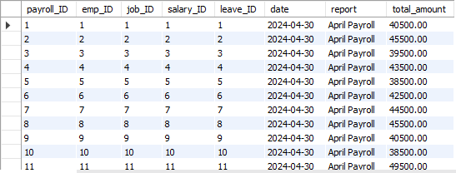
Qualification
Leaves
Payroll

Slide 6
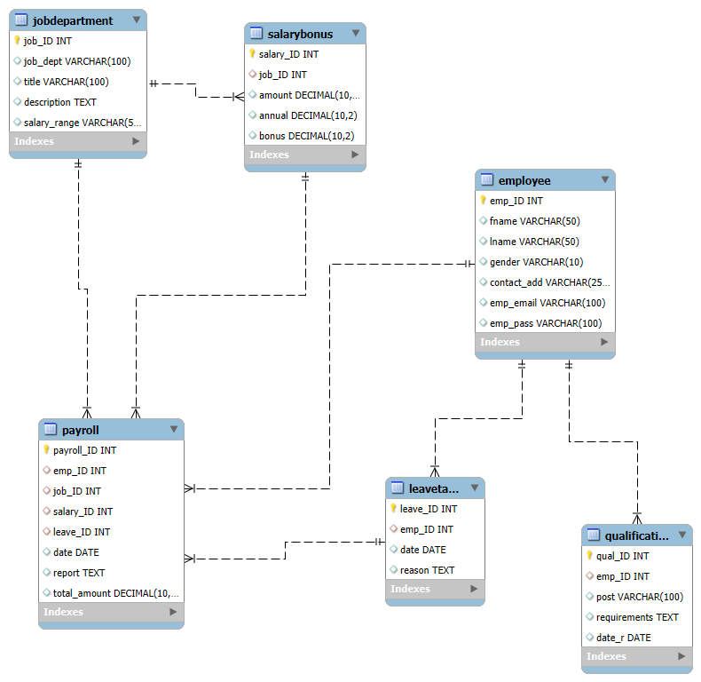
ER DIAGRAM

Slide 7
PROBLEM STATEMENT
The Employee Management System (EMS) is designed to efficiently manage employee information, job roles, departments, payroll, qualifications, and leaves within an organization. The system ensures data integrity through relational tables with foreign keys and cascading actions. It also supports analytical queries to provide insights into workforce distribution, salaries, bonuses, leave patterns, and payroll expenses—streamlining HR operations and decision-making.

Slide 8



1.How many unique employees are currently in the system?

Slide 9
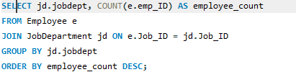
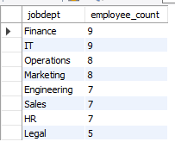
2.Which departments have the highest number of employees?

Slide 10
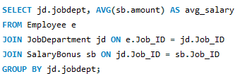
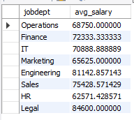
3.What is the average salary per department?

Slide 11
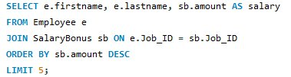
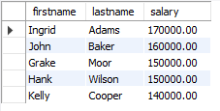


4.Who are the top 5 highest-paid employees?

Slide 12


5.What is the total salary expenditure across the company?

Slide 13

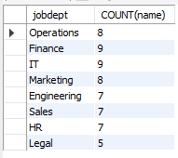
6.How many different job roles exist in each department?

Slide 14
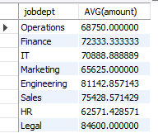

7.What is the average salary range per department?

Slide 15
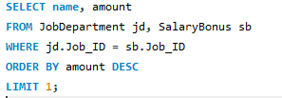

8.Which job roles offer the highest salary?

Slide 16
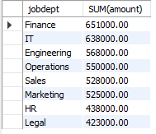
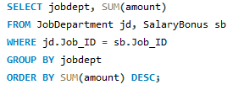
9.Which departments have the highest total salary allocation?

Slide 17


10.How many employees have at least one qualification listed?

Slide 18
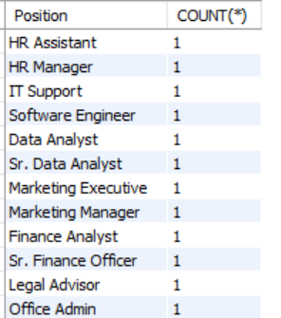

11.Which positions require the most qualifications?

Slide 19
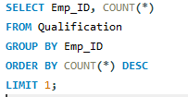

12. Which employees have the highest number of qualifications?

Slide 20


13.Which year had the most employees taking leaves?

Slide 21
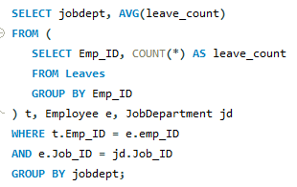
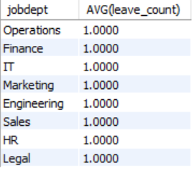
14.What is the average number of leave days taken by its employees per department?

Slide 22
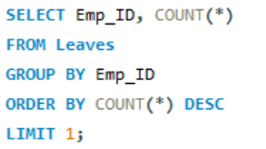



15.Which employees have taken the most leaves?

Slide 23




16.What is the total number of leave days taken company-wide?

Slide 24


17.How do leave days correlate with payroll amounts?

Slide 25
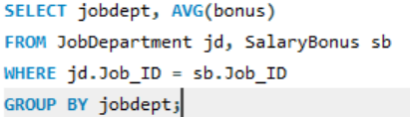
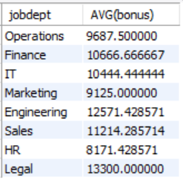
18.What is the total monthly payroll processed?

Slide 26
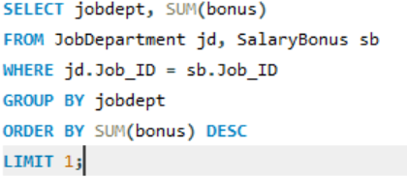


19.What is the average bonus given per department?

Slide 27


20.Which department receives the highest total bonuses?

Slide 28
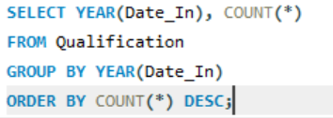
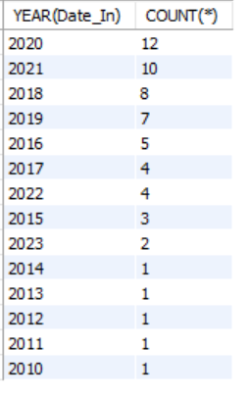
21.What is the average value of total_amount after considering leave deductions?

Slide 29
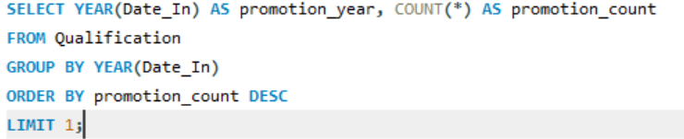

22.Which year had the highest number of employee promotions?

Slide 30
CONCLUSION
The Employee Management System Database (EMSDB) is a centralized platform for managing employee details, payroll, leaves, and qualifications efficiently. It ensures data consistency and provides meaningful insights for HR and management decision-making. The system streamlines employee-related processes, improving accuracy and productivity. Future enhancements include automation, web application development, and cloud integration for scalability.

Slide 31


Thank You

